Slide 1
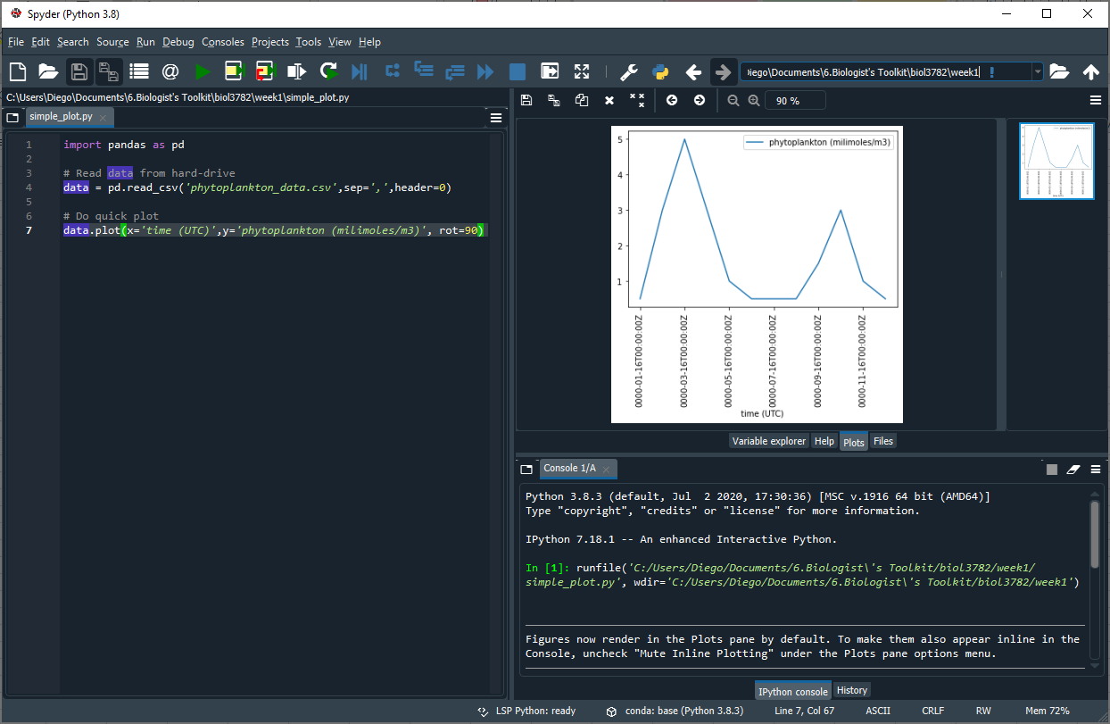

Slide 2
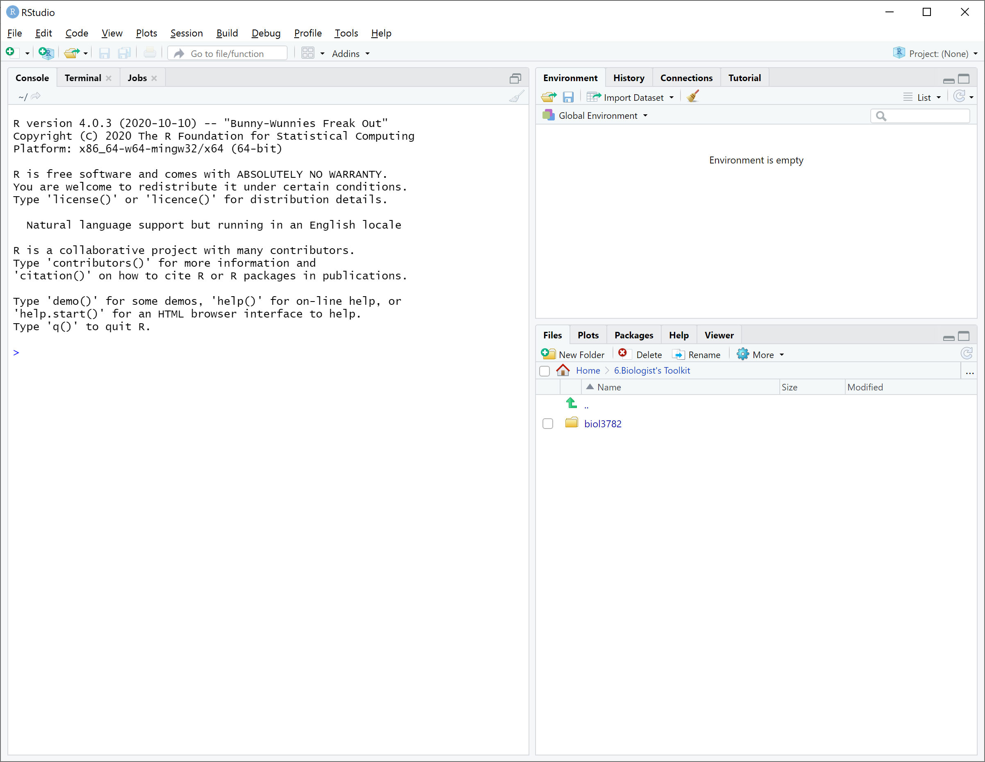

Slide 3
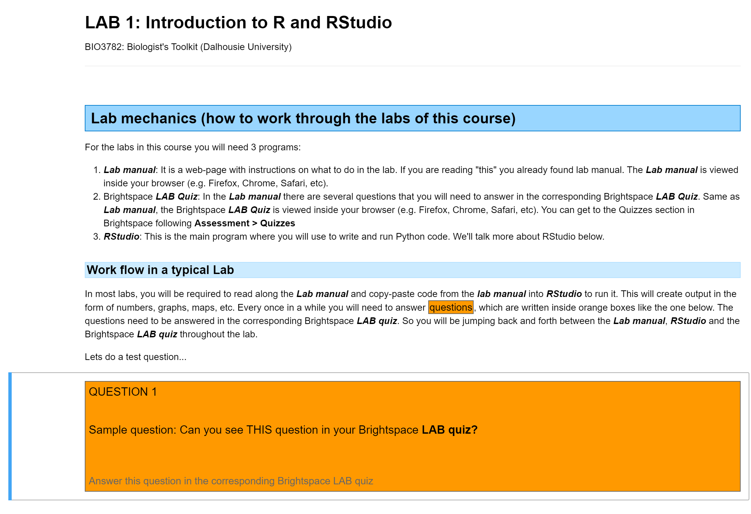
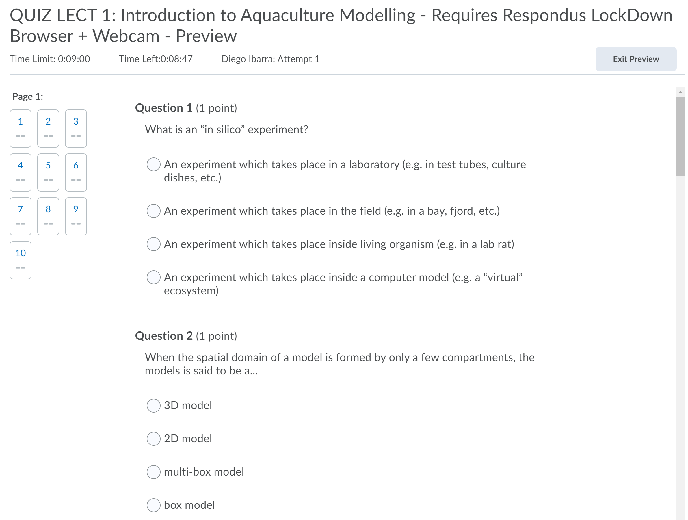
Lab manual
Brightspace Quiz
RStudio

Slide 4
CONSOLE

Slide 5
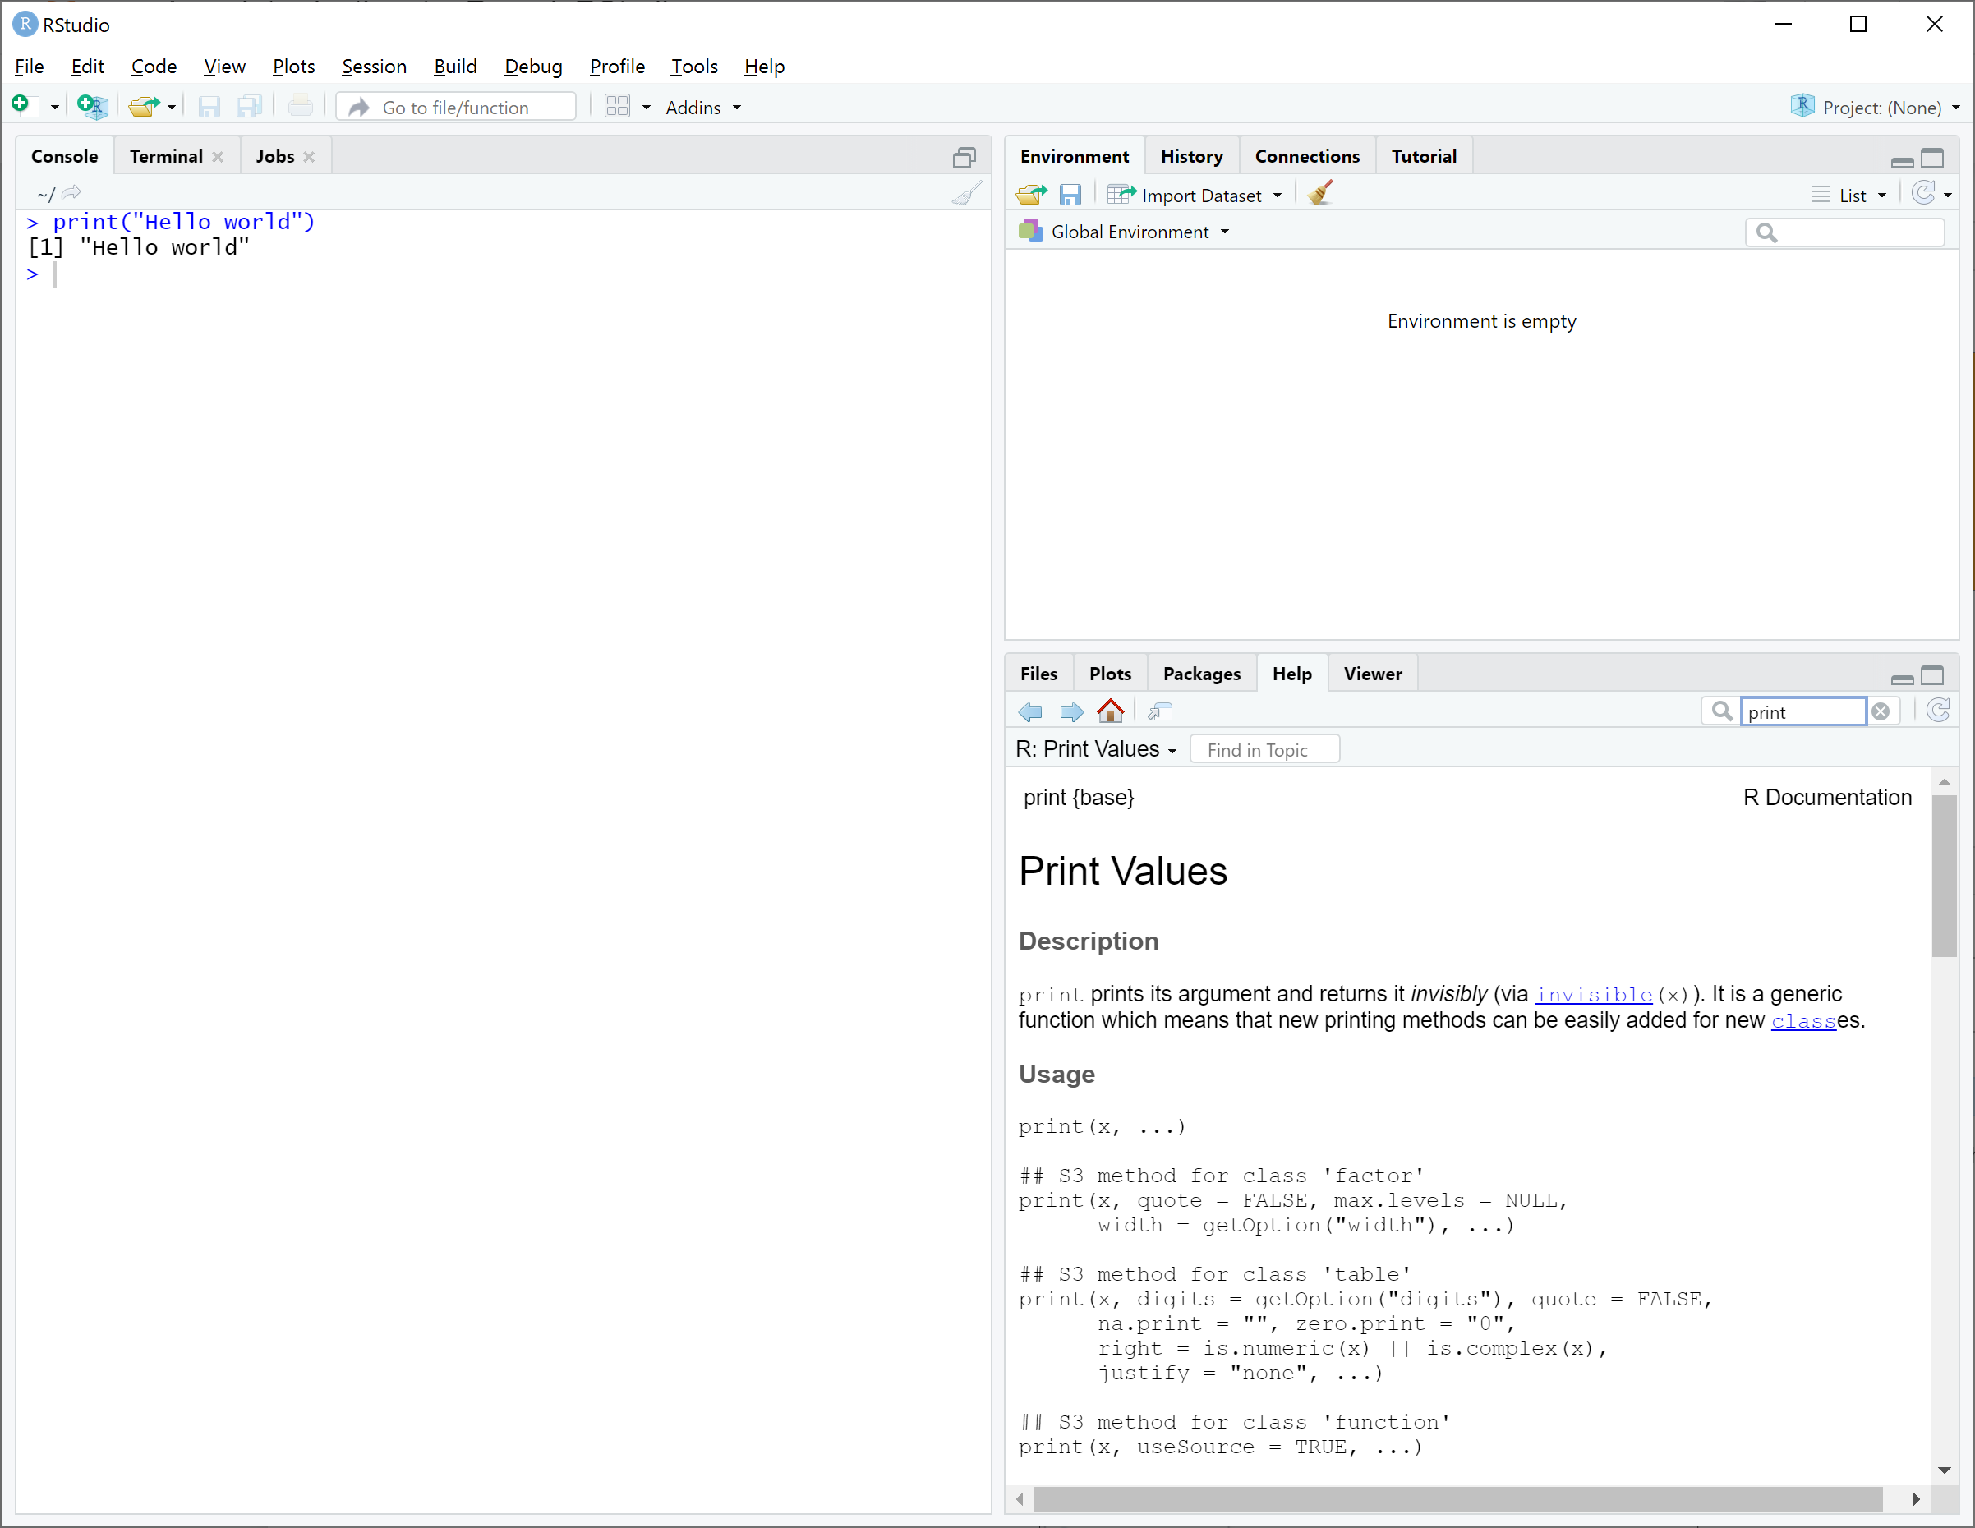
Tab
Search bar
Help panel

Slide 6
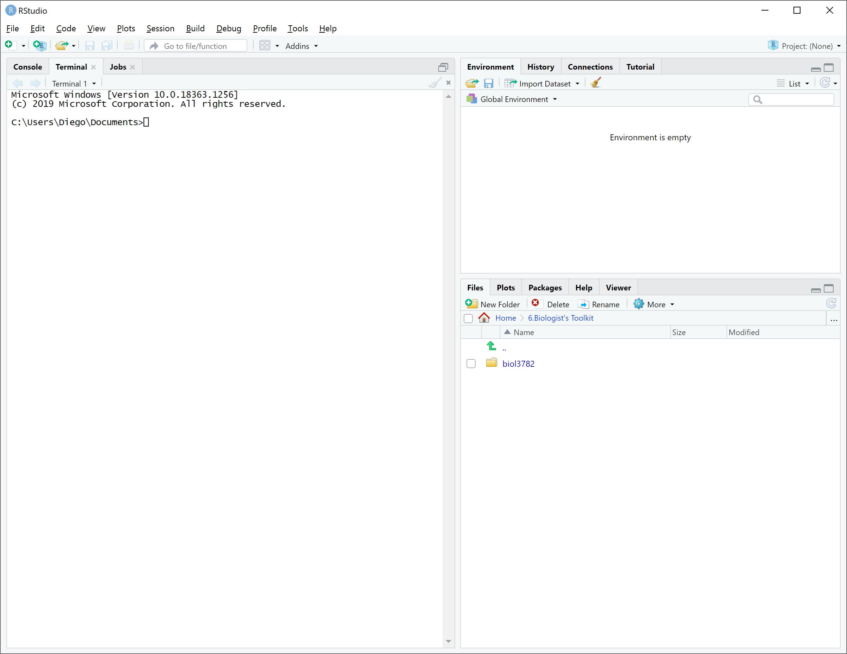

Slide 7
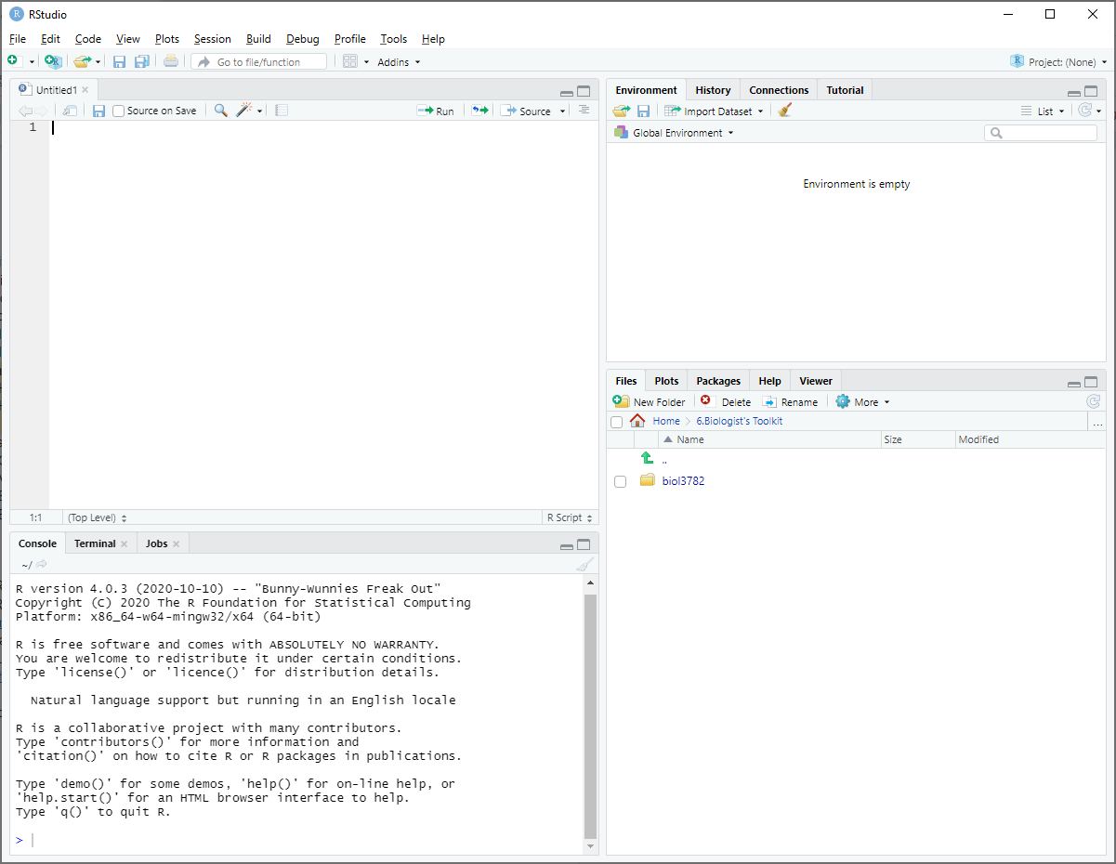

Slide 8
Editor

Slide 9
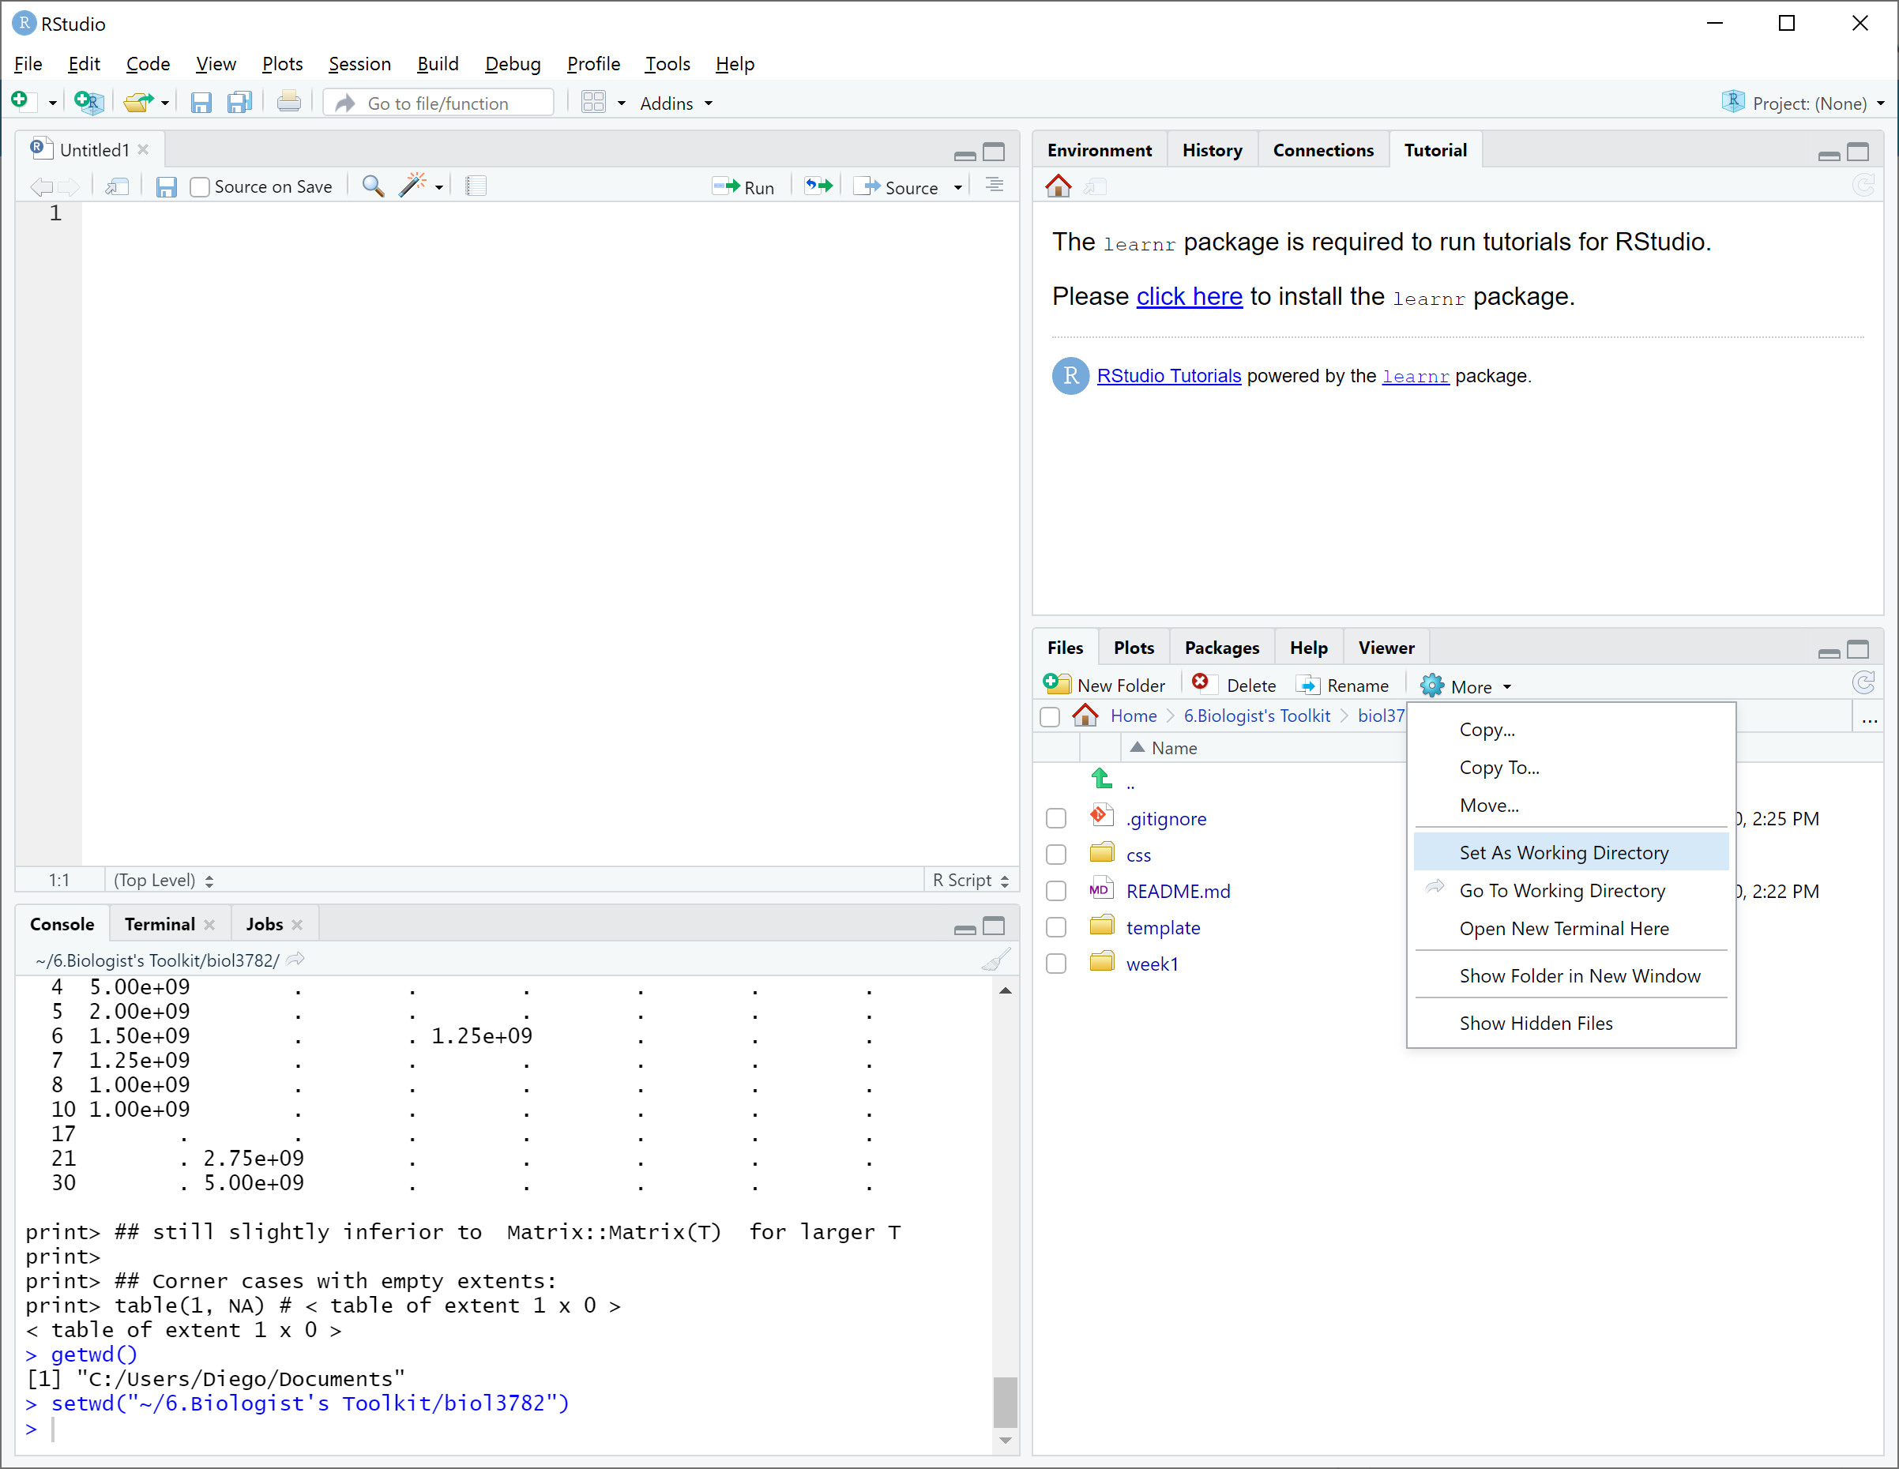

Slide 10
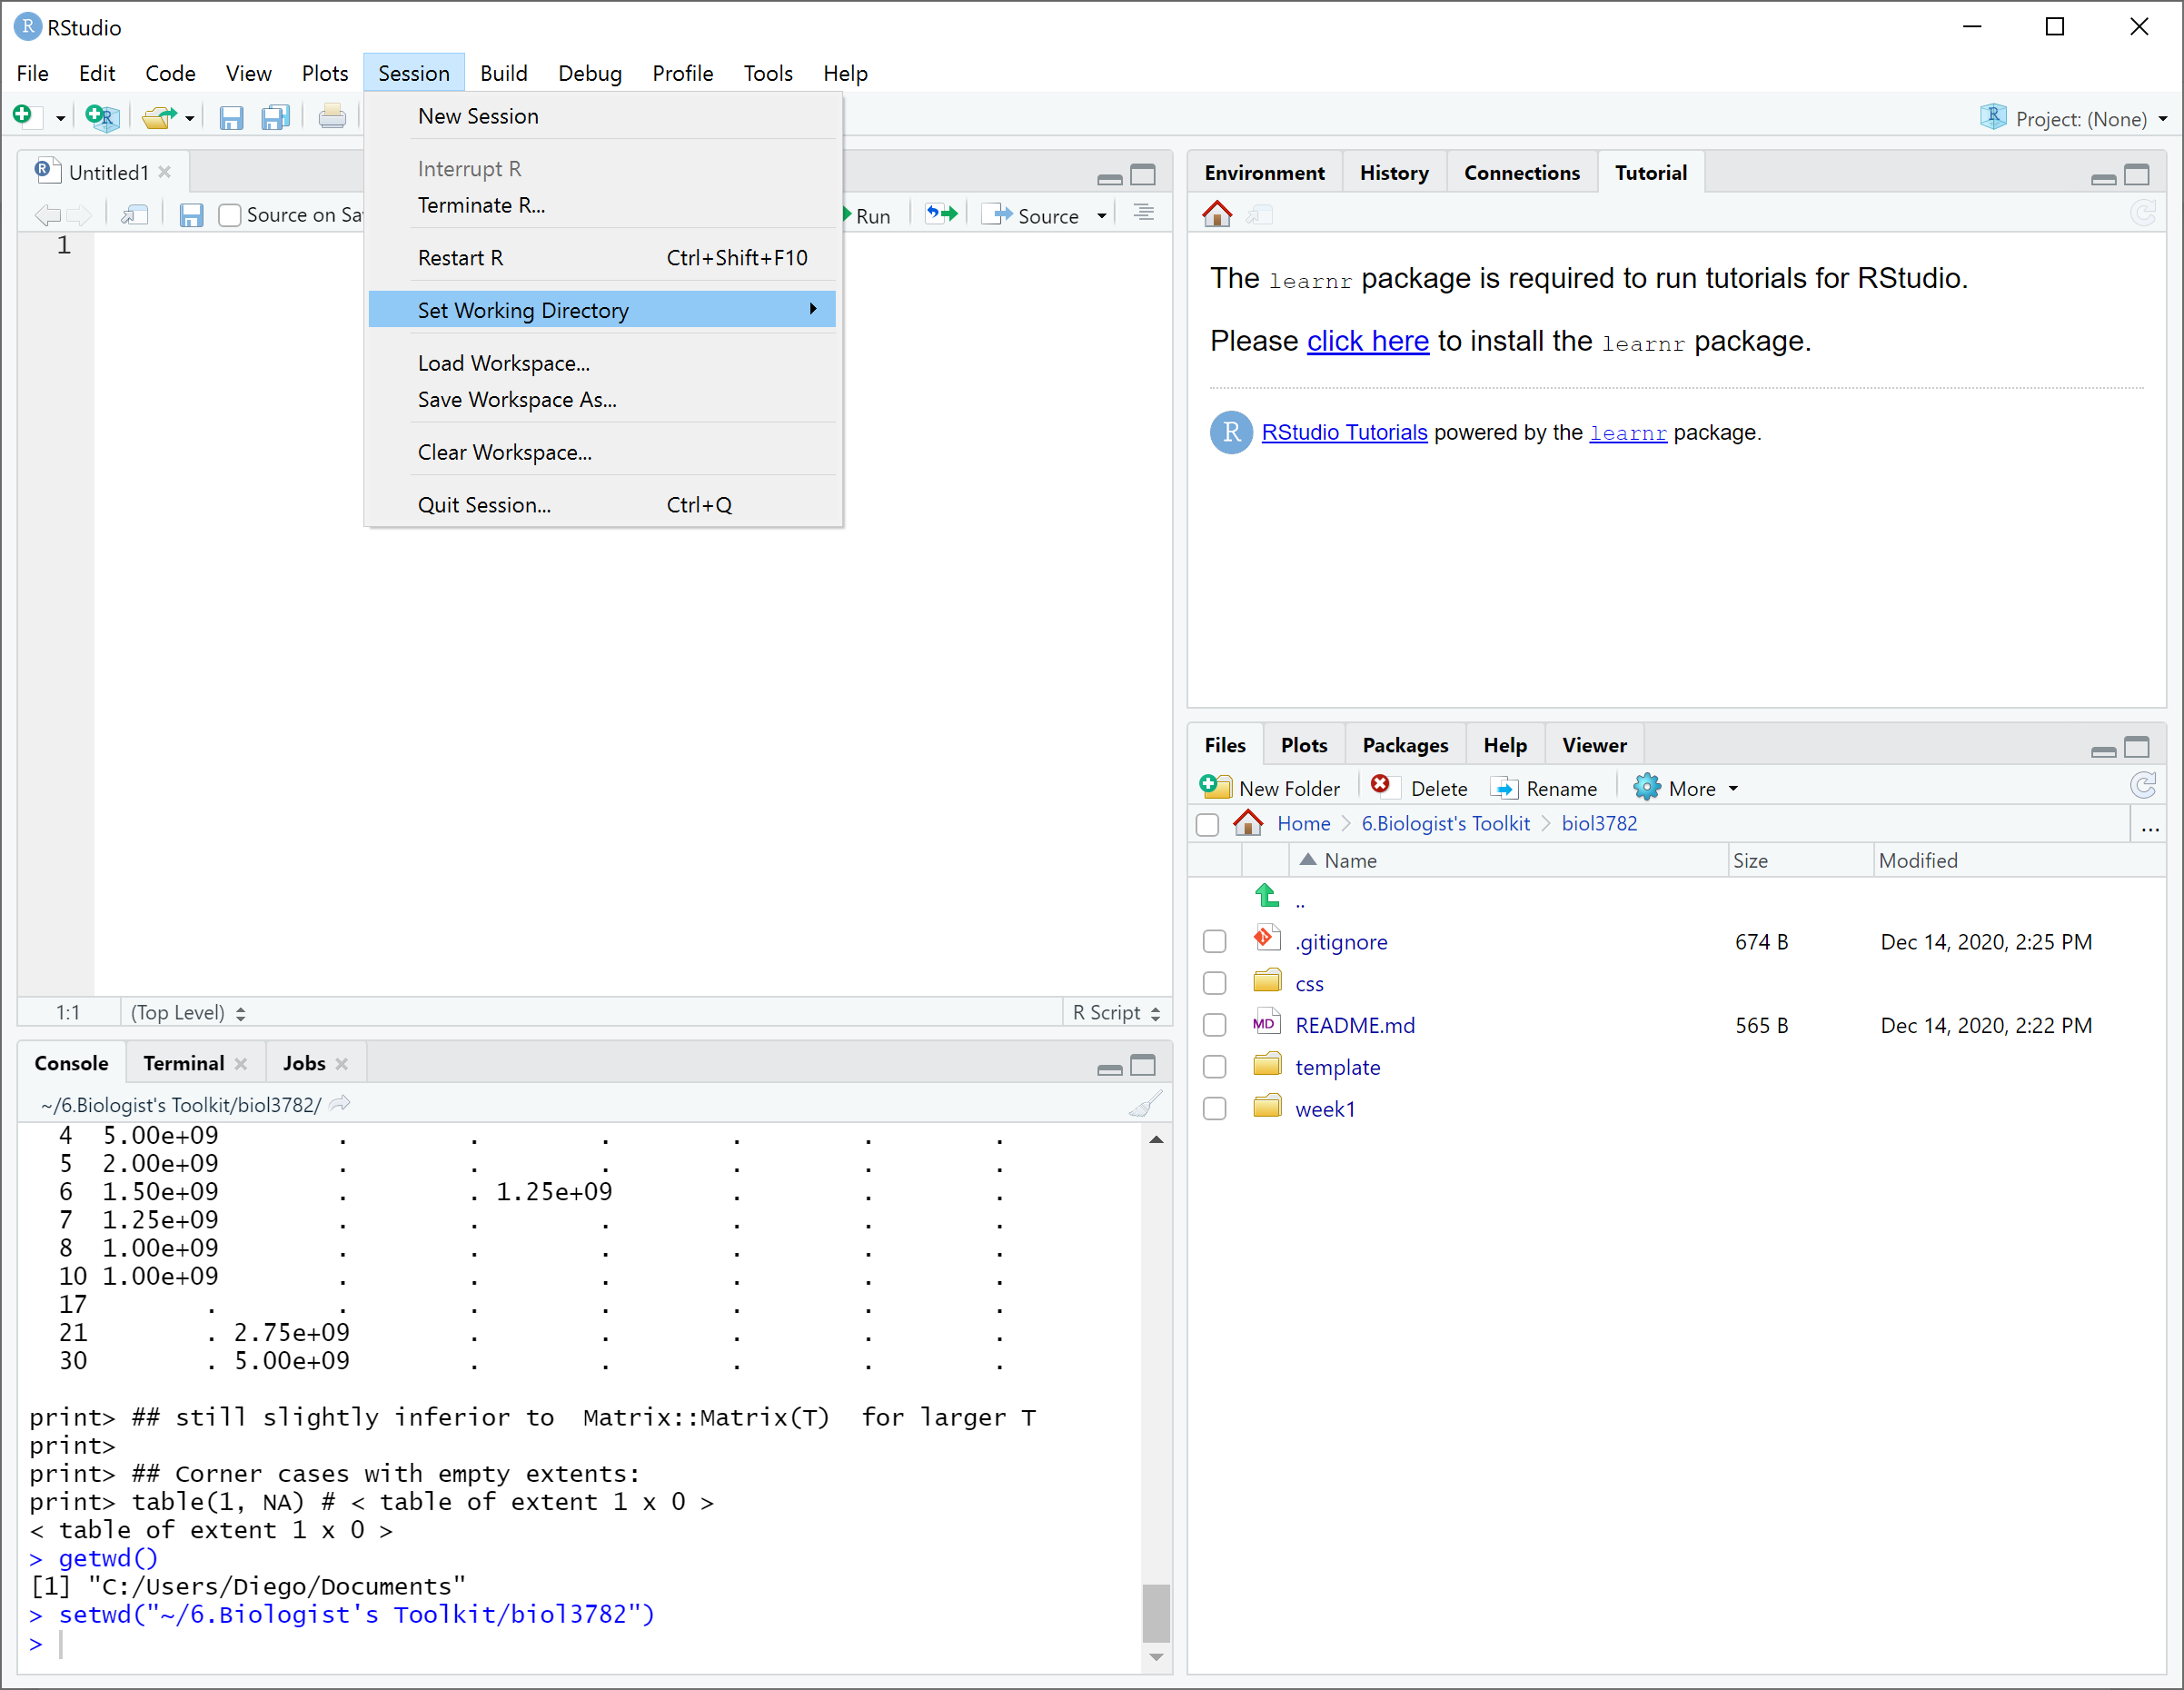

Slide 11
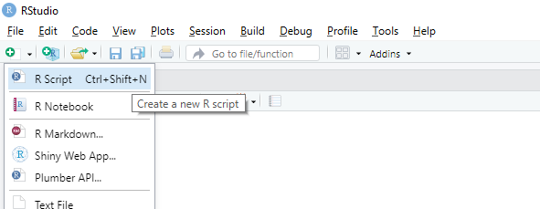

Slide 12
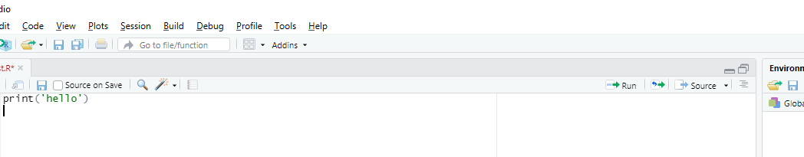
Buttons to run code

Slide 13
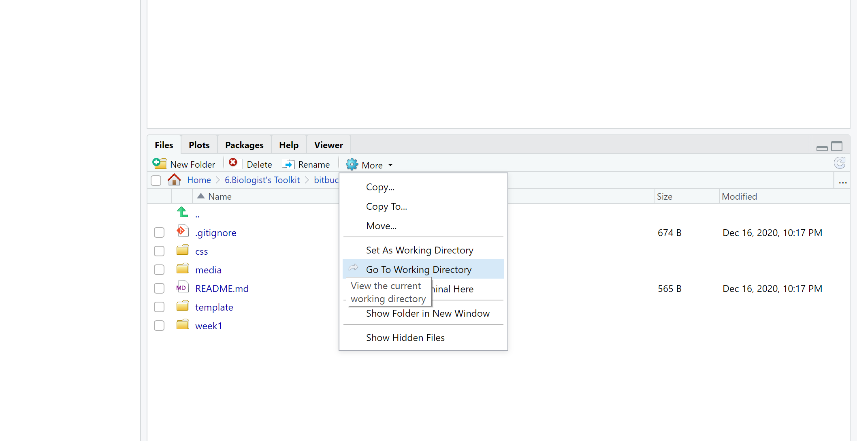

Slide 14
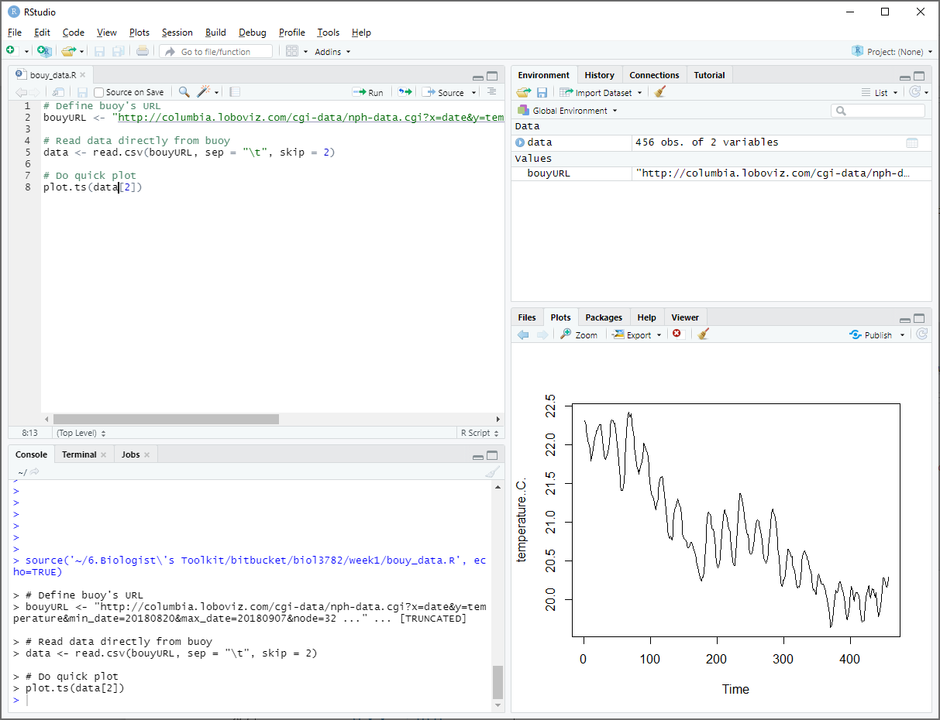
Plots panel

Slide 15
Environment panel

Slide 16
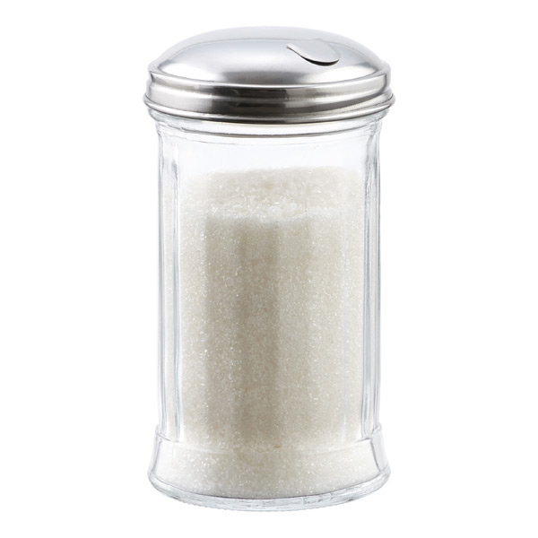

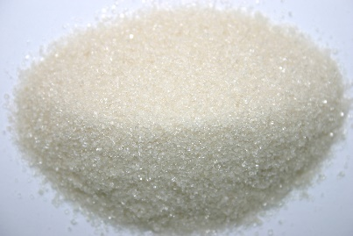
Sugar

Slide 17
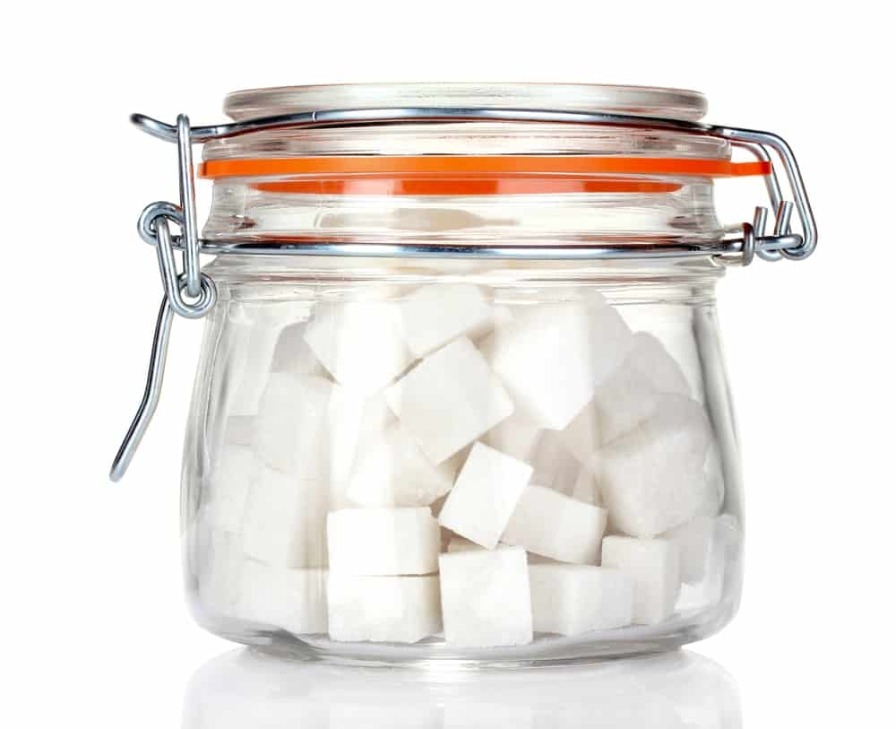
Sugar

Slide 18
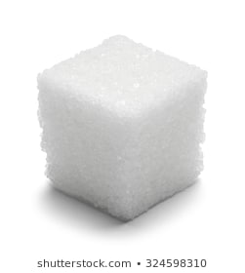
Sugar

Slide 19
8
5
3
1
9
2

Slide 20
7L
“hello”
3.6
7
5
2
9
“world”

Slide 21
2
5
0
4
3
6
7
9
8
3
7
2

Slide 22
x
y
z
2
3
4
3
4
5
4
5
6
5
6
7
6
7
8

